Slide 1

Advanced NLP (Python Library for NLP)
NLP
Dr. Sajarwo Anggai, S.ST., M.T. NIDN : 0421108703

Slide 2
NLP Pipeline
Text Preprocessing
Feature Extraction
Modeling
Post-Processing
Deployment
Segmentation/ Tokenization
Normalization/ Lowercasing
Stopword Removal
Punctuation Removal
Stemming/ Lemmatization
Depedency parsing
Part-of-Speech Tagging
Bag of Words (BoW)
TF-IDF
Word Embeddings
Machine Learning
Deep Learning
Prediction
Evaluation
Fine-Tuning
Production
Monitoring and Updating

Slide 3
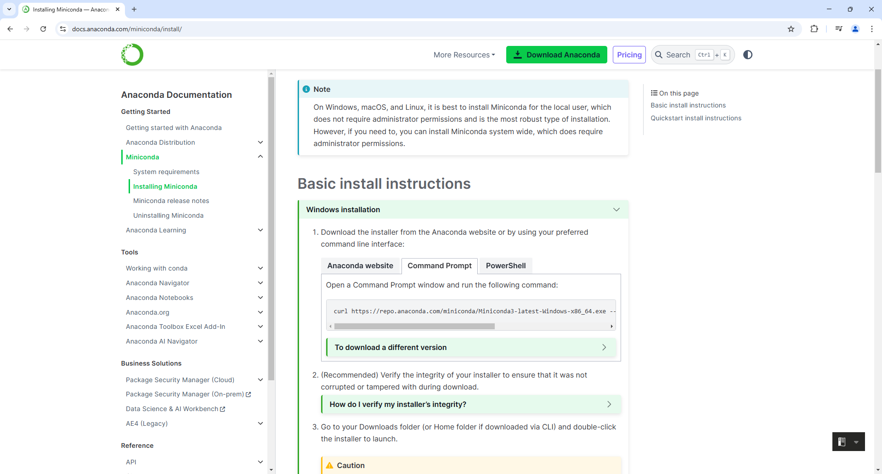
Installing Miniconda
https://docs.anaconda.com/miniconda/install/

Slide 4
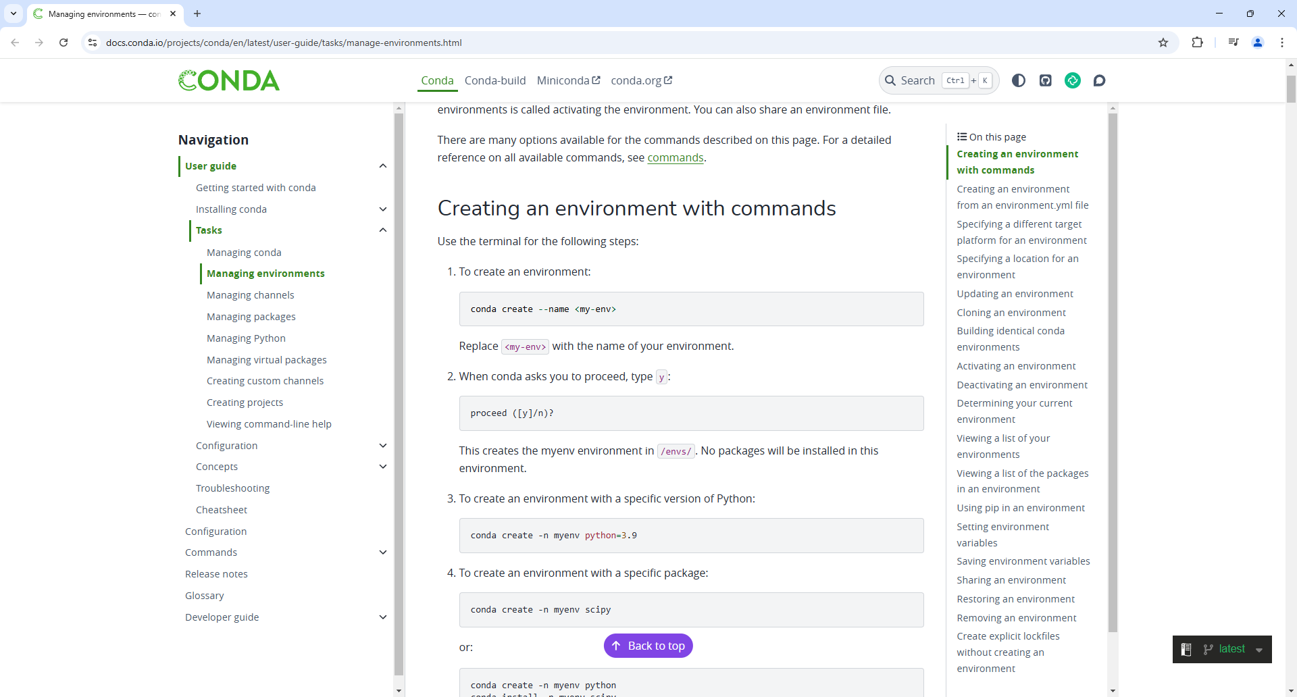
Manage Environments
https://docs.conda.io/projects/conda/en/latest/user-guide/tasks/manage-environments.html

Slide 5
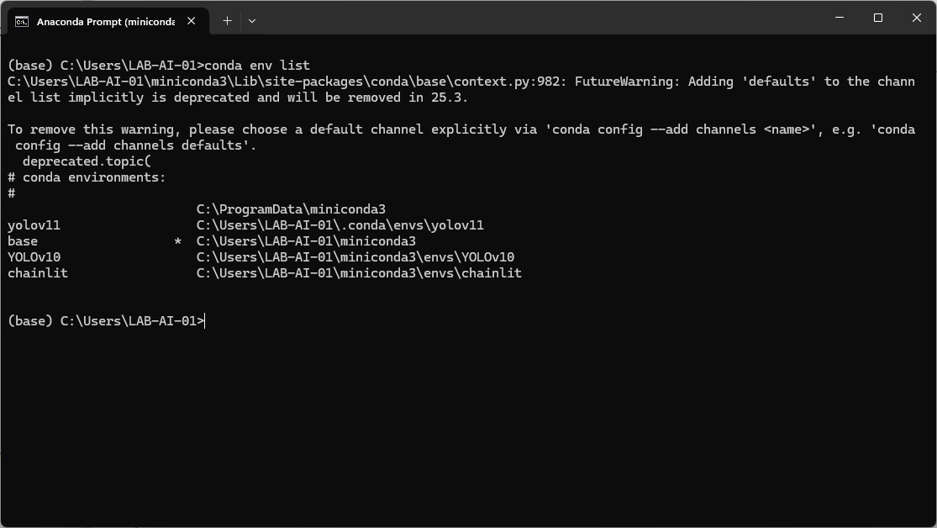
Manage Environments conda env list

Slide 6
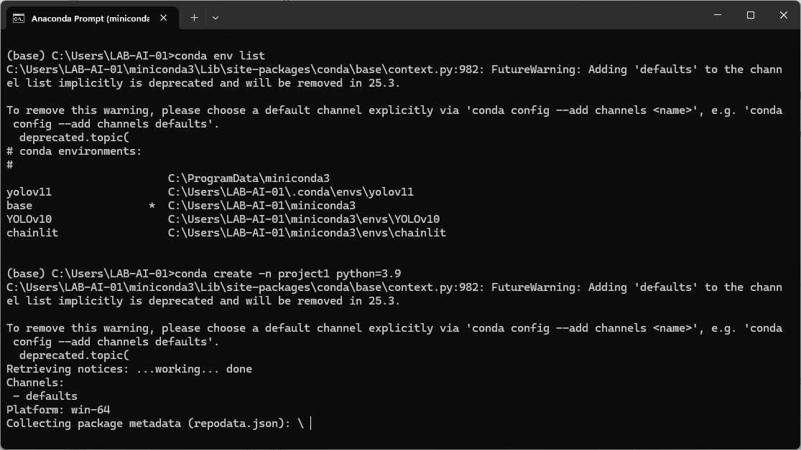
Manage Environments conda create project 1 python=3.9

Slide 7
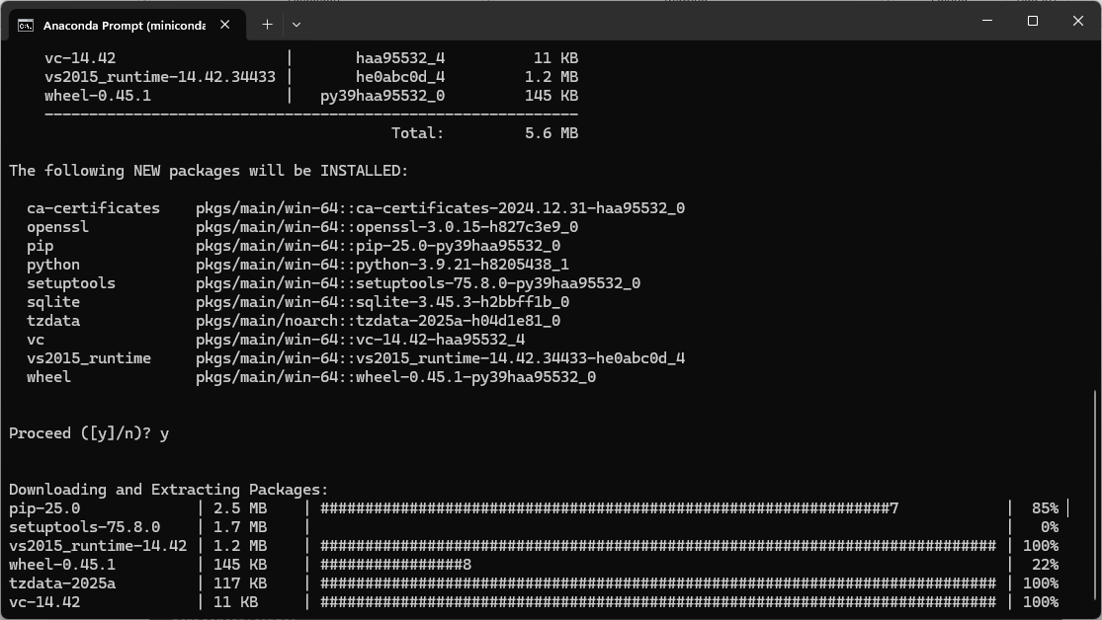
Manage Environments conda create project 1 python=3.9

Slide 8
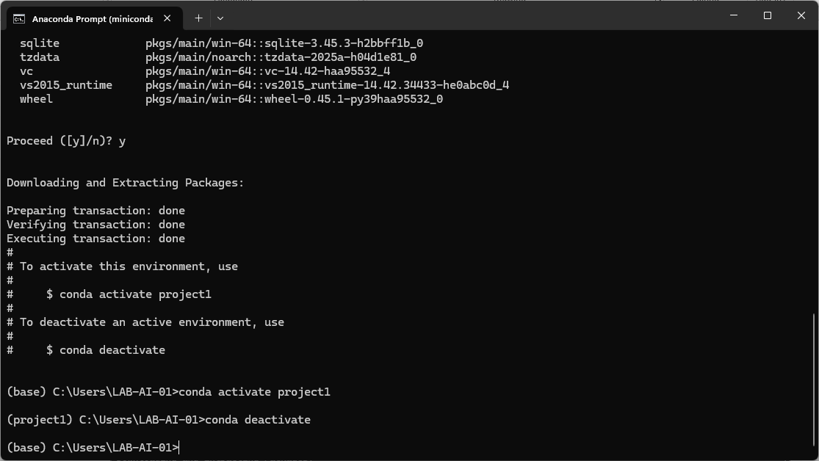
Manage Environments conda activate project 1

Slide 9
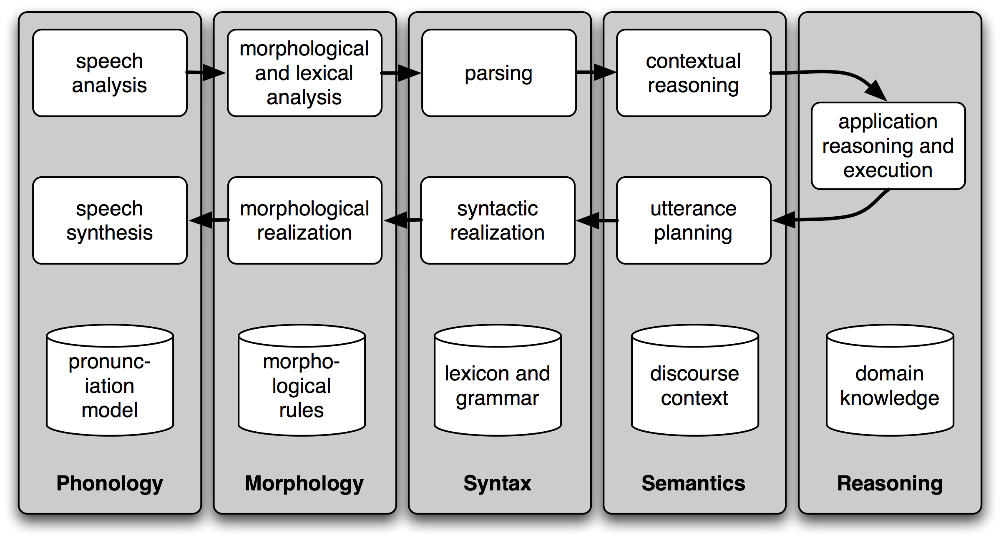
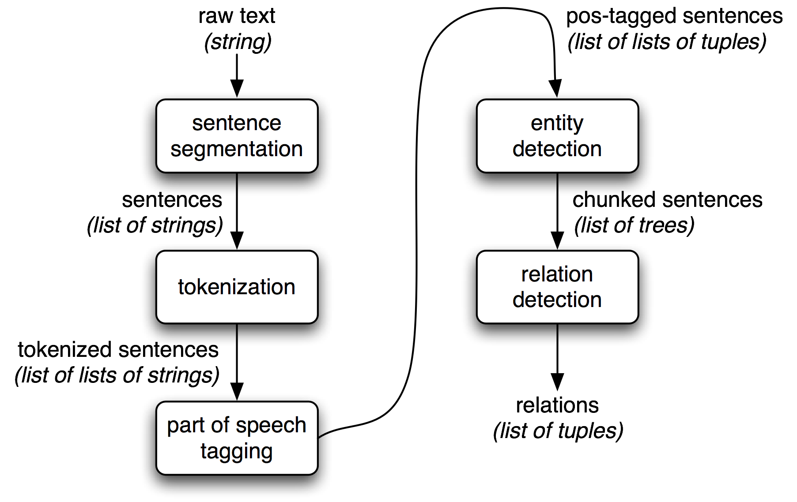
Natural Language Toolkit - NLTK
https://www.nltk.org/

Slide 10
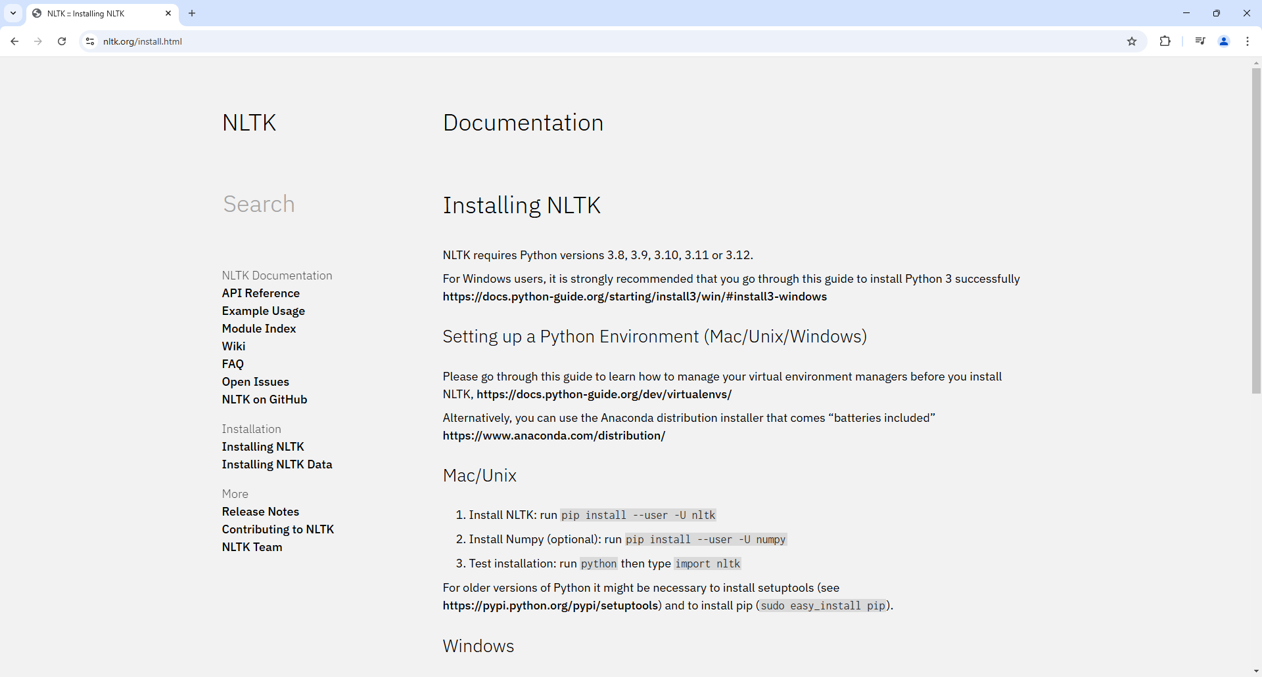
Natural Language Toolkit - NLTK
https://www.nltk.org/

Slide 11
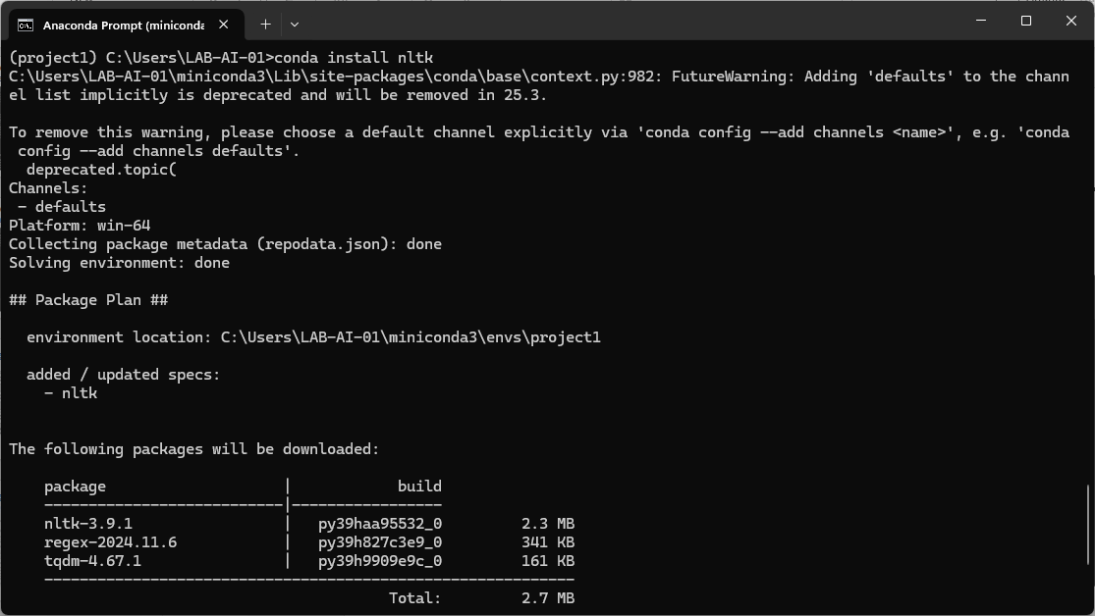
Natural Language Toolkit - NLTK

Slide 12
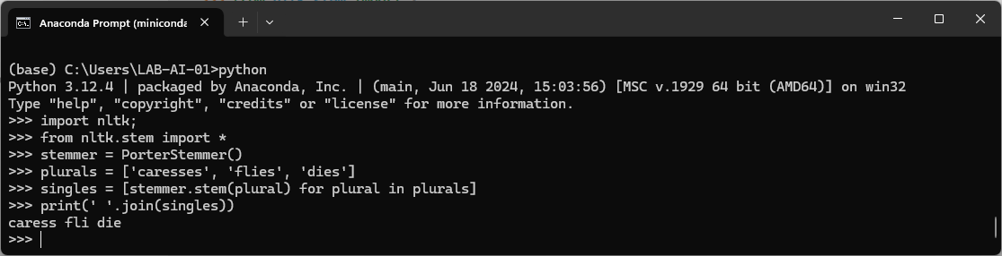
Natural Language Toolkit - NLTK

Slide 13
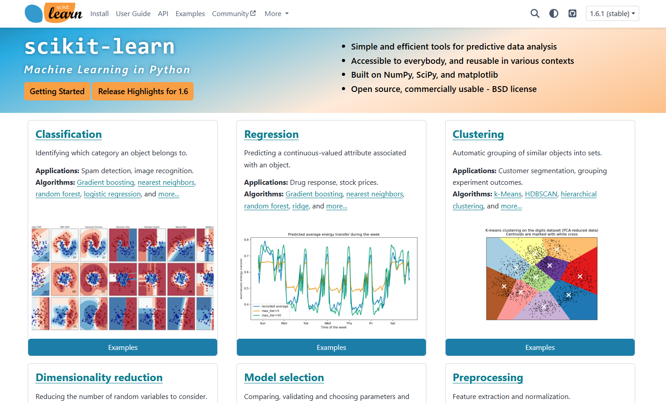
scikit-learn
https://scikit-learn.org/stable/

Slide 14
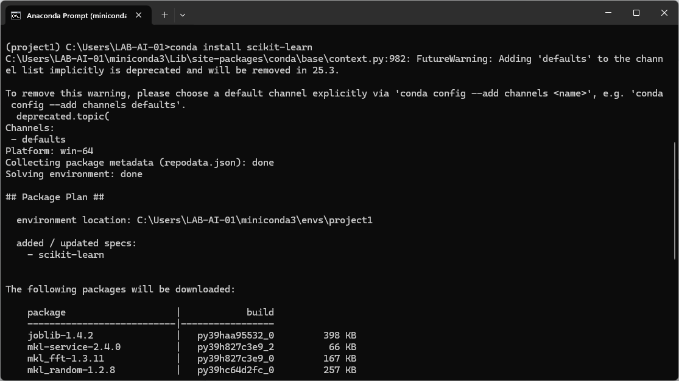
scikit-learn

Slide 15
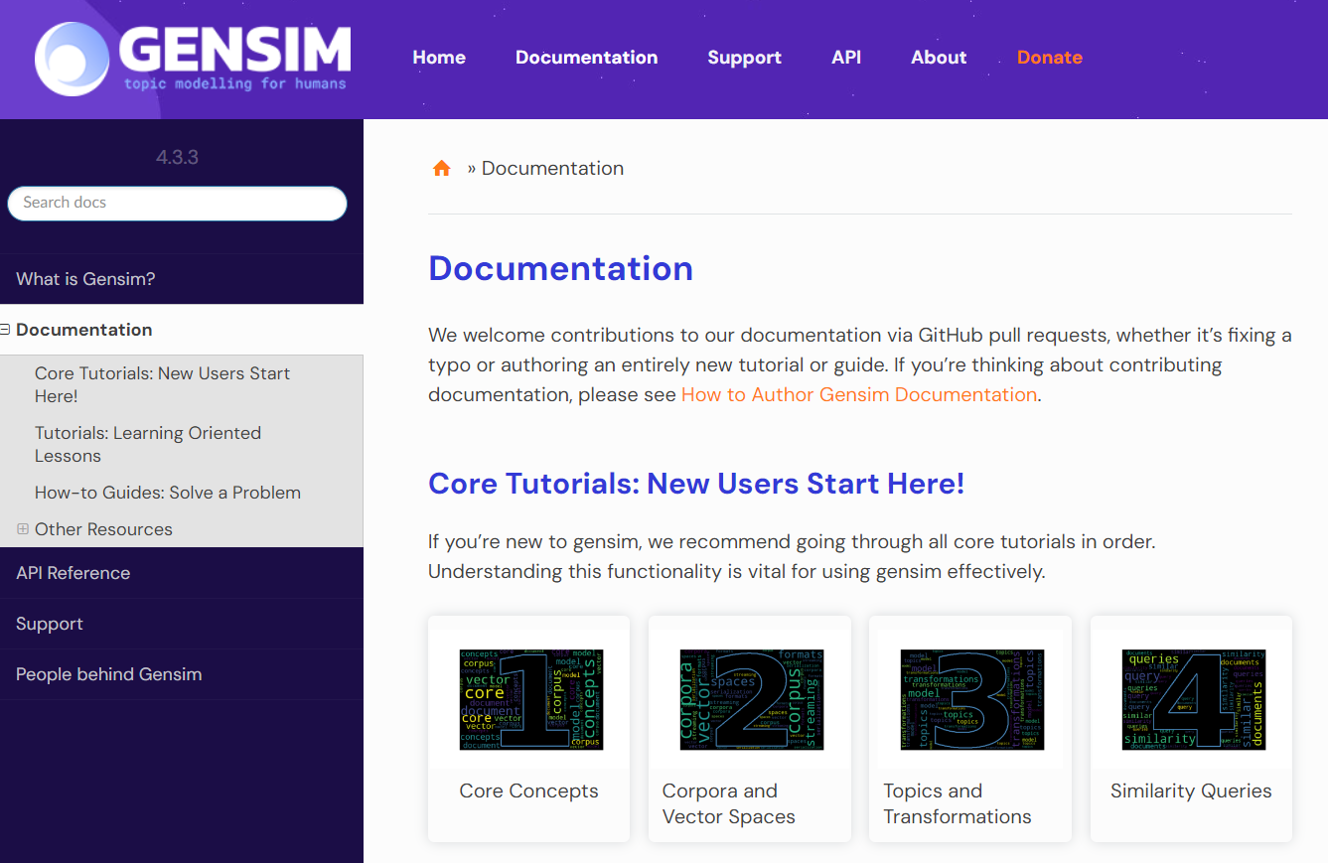
Gensim
https://radimrehurek.com/gensim/index.html

Slide 16
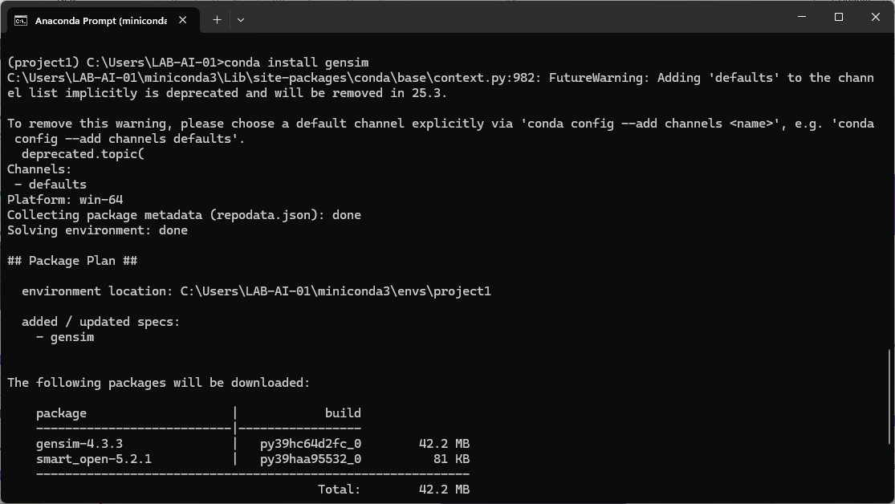
Gensim

Slide 17
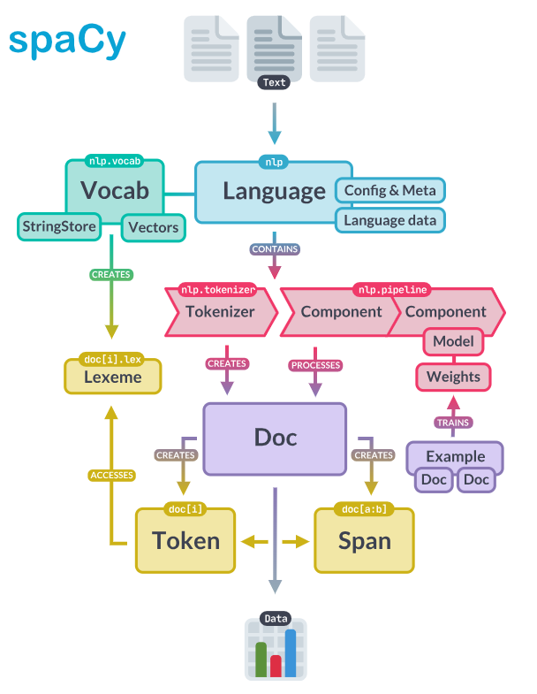
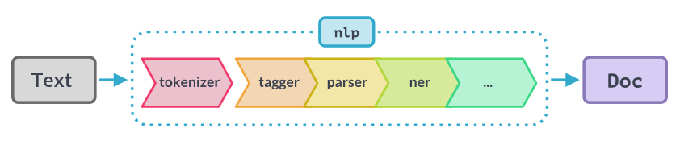
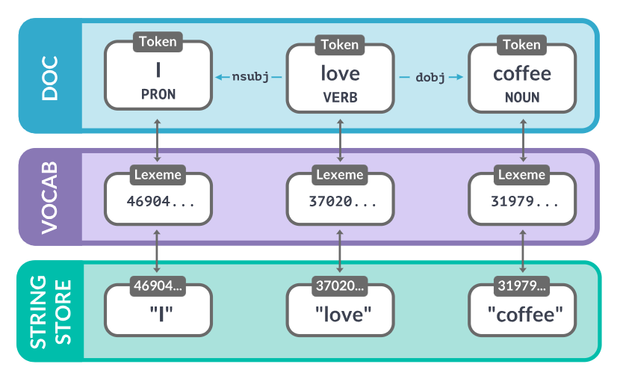
spaCy
https://spacy.io/usage/spacy-101#pipelines

Slide 18
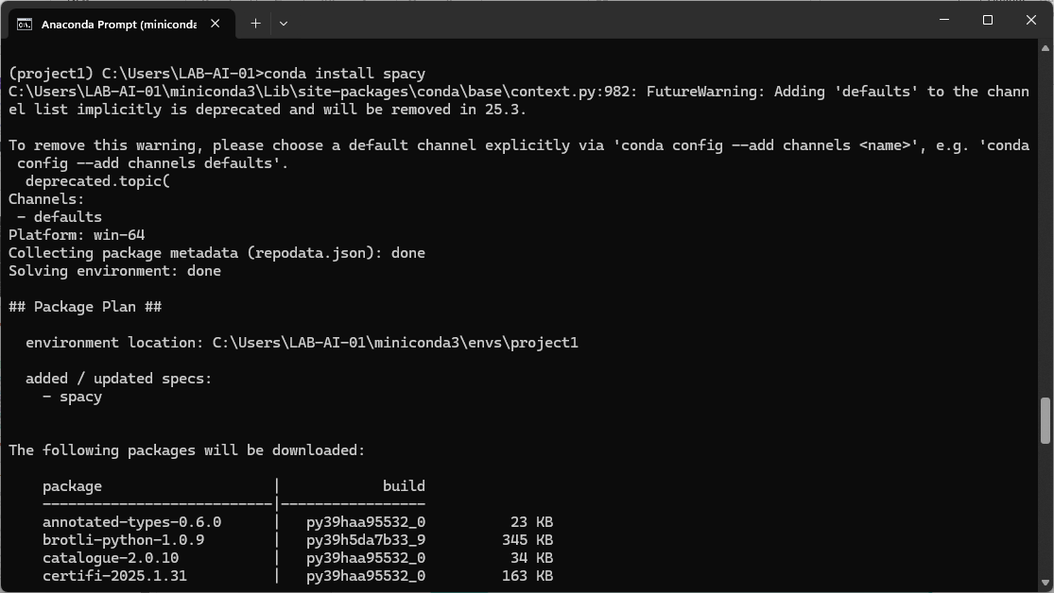
spaCy

Slide 19
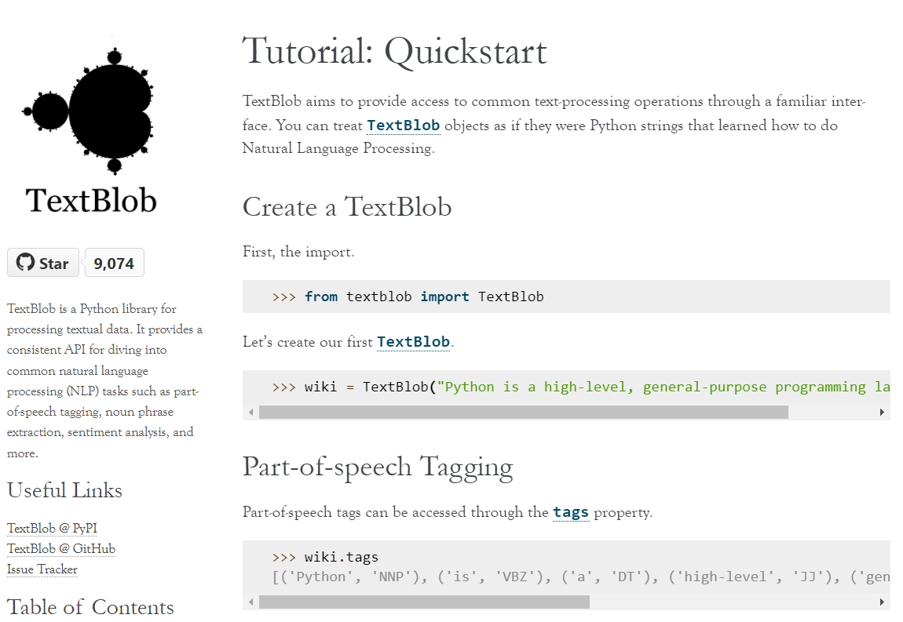
TextBlob

Slide 20
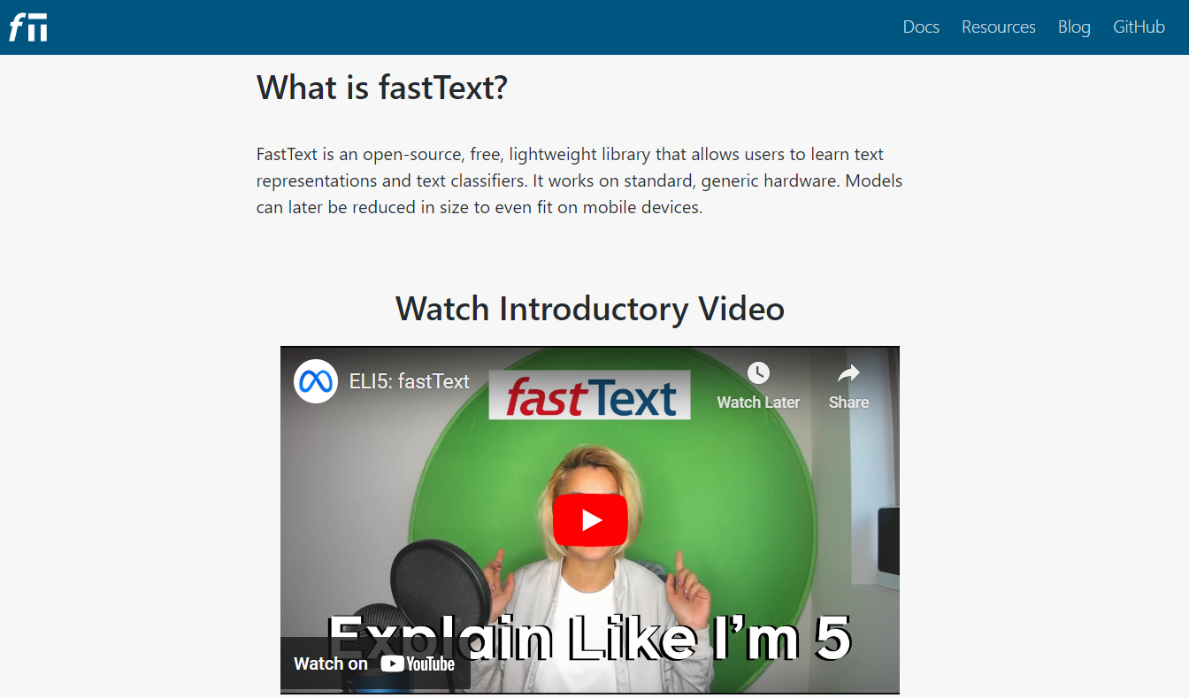
fastText

Slide 21
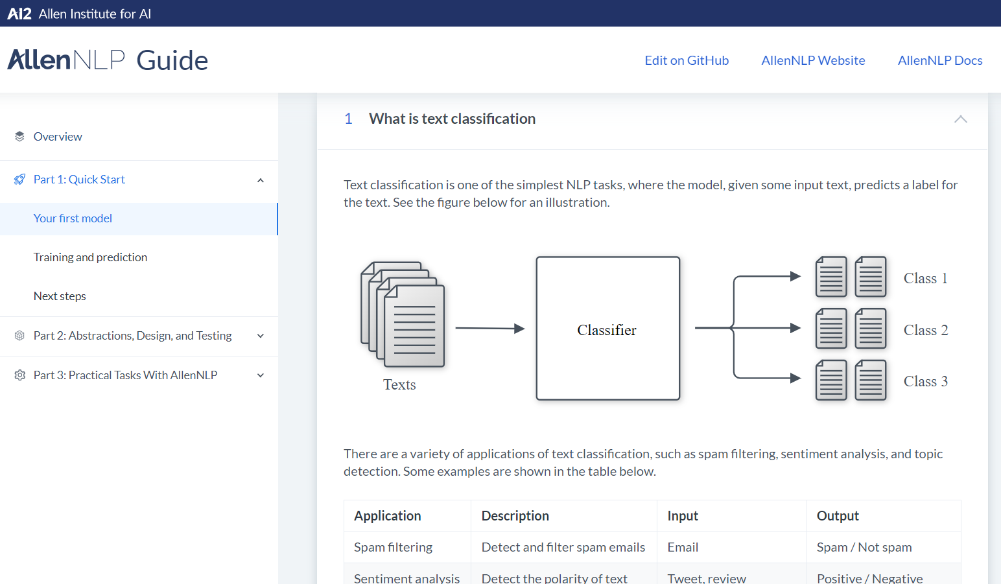
AllenNLP

Slide 22
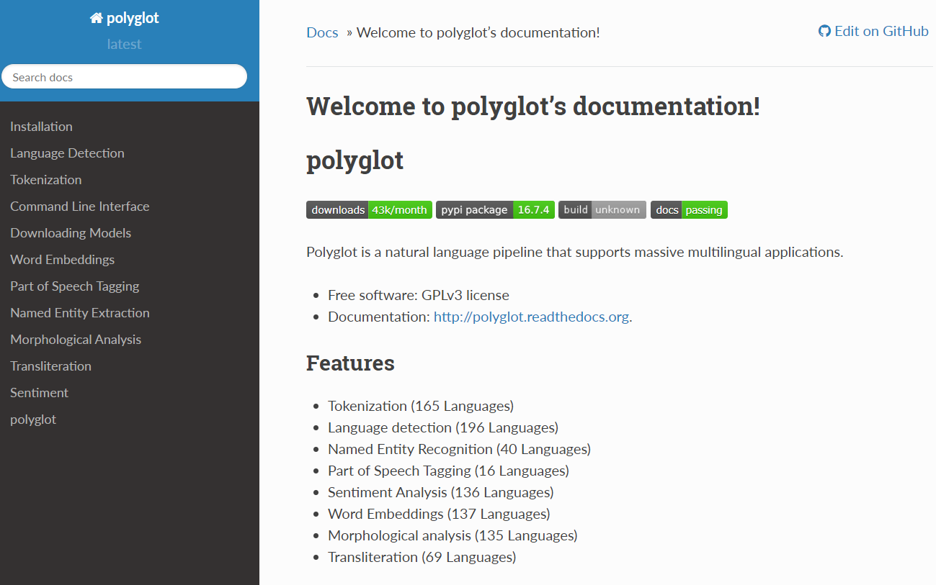
polyglot
https://polyglot.readthedocs.io/en/latest/index.html

Slide 23
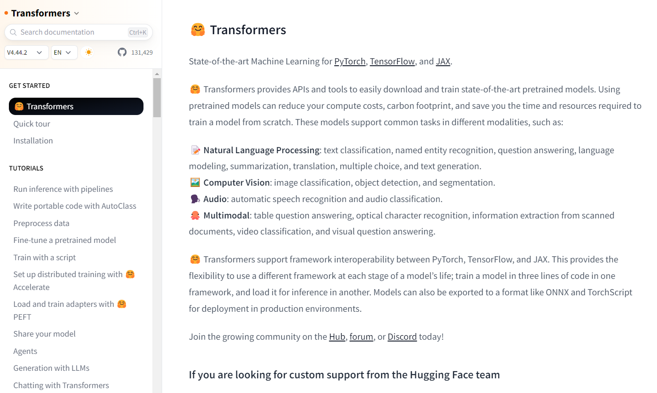
Hugging Face Transformers

Slide 24
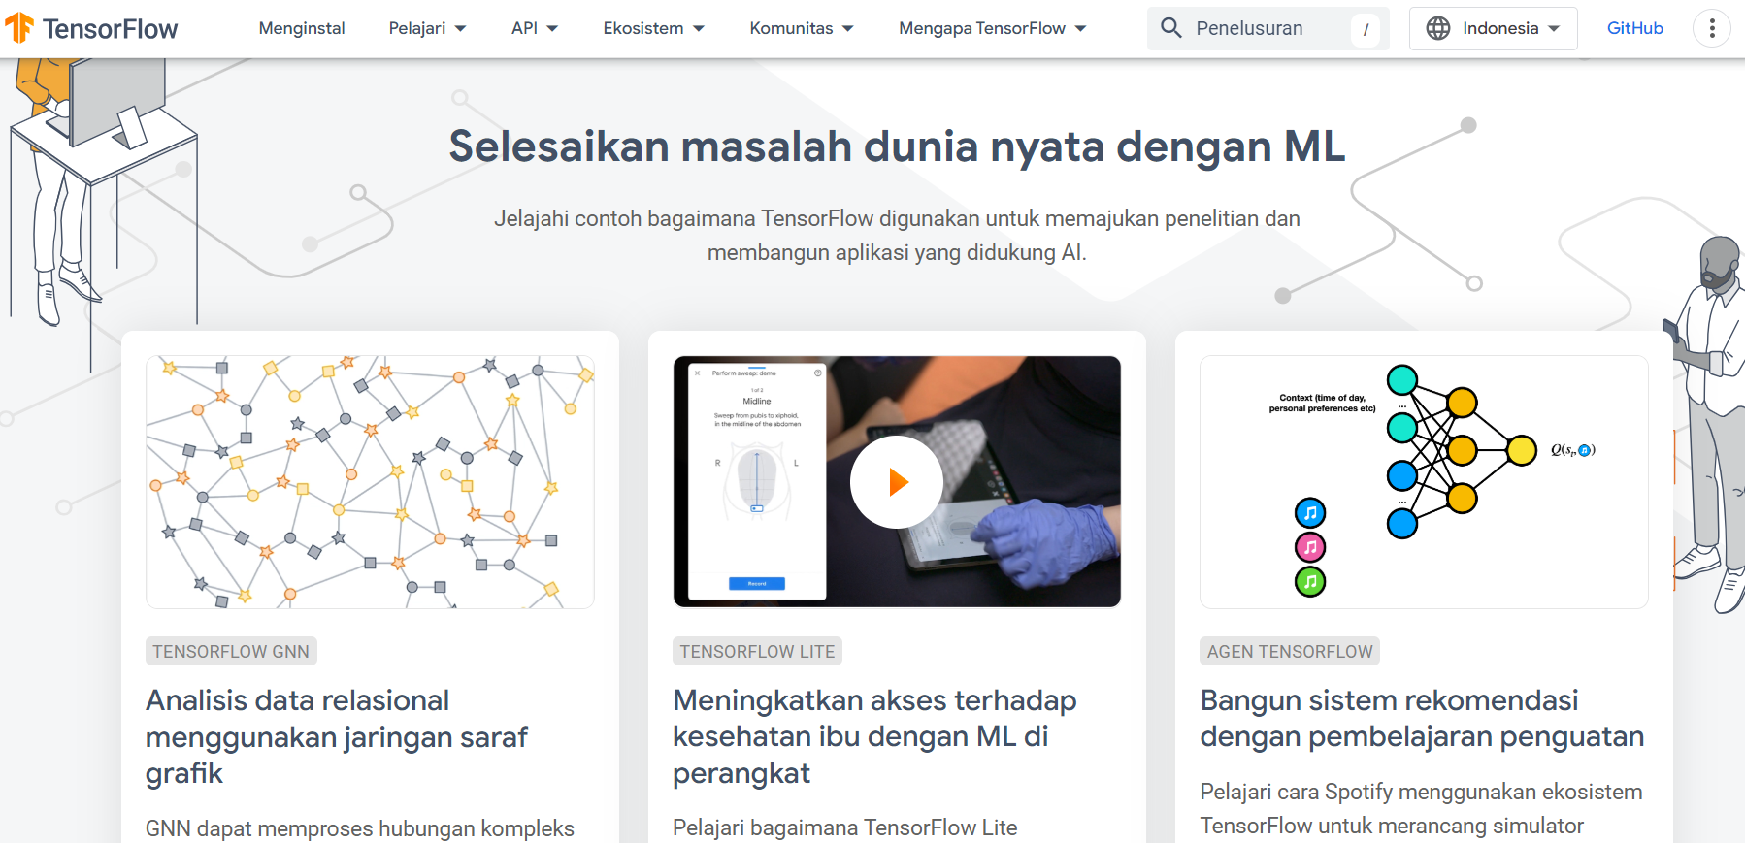
TensorFlow

Slide 25
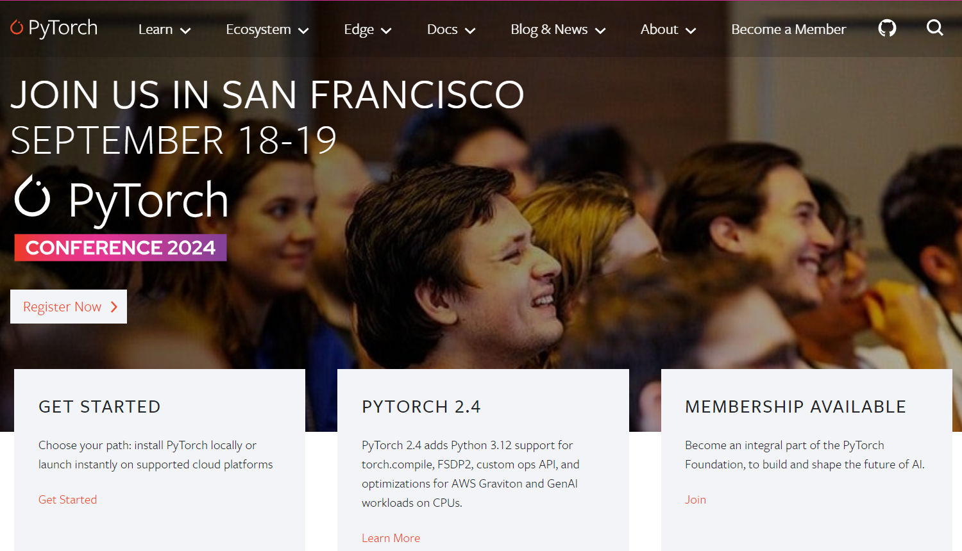
PyTorch

Slide 26
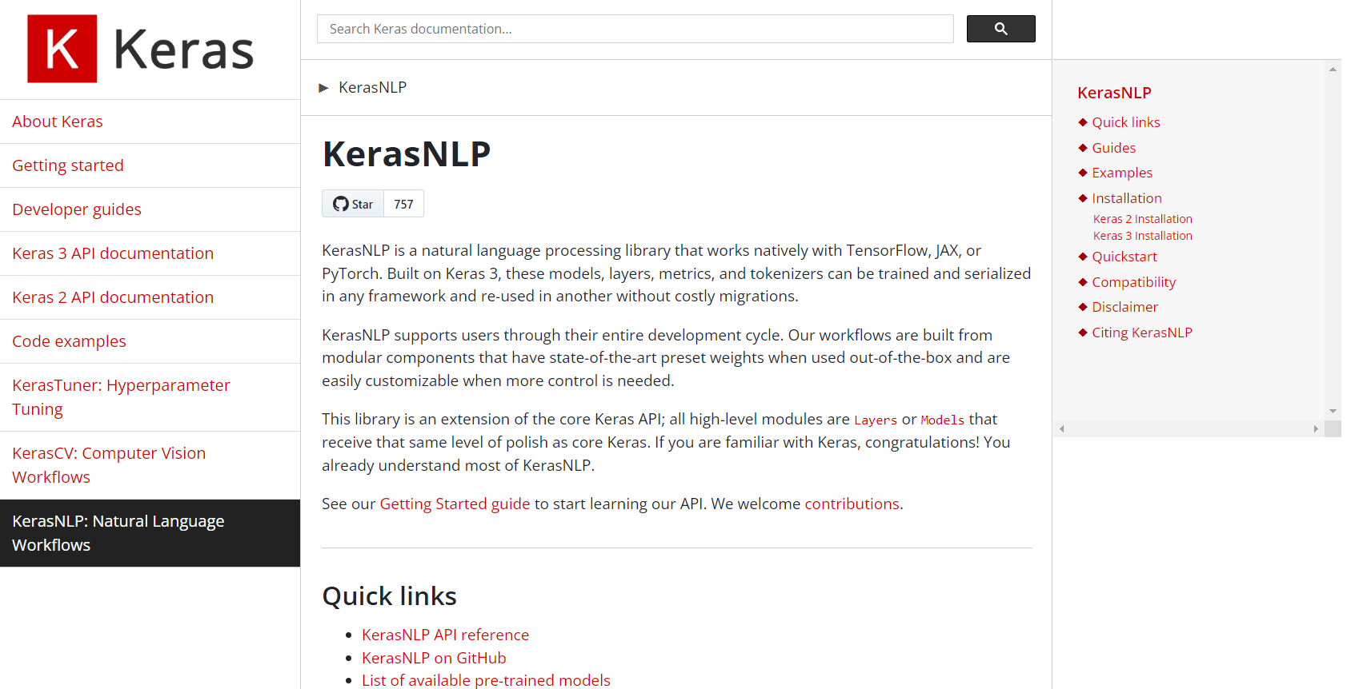
Keras

Slide 27

Universitas Pamulang
Prodi Teknik Informatika S-2
Sajarwo Anggai
Dosen – Universitas Pamulang
NIDN : 0421108703
Email : dosen02832@unpam.ac.id
WA : 08977406656
Terima Kasih

